Slide 1

EMBSYS 105 Programming with Embedded & Real-Time Operating Systems
Instructor: Nick Strathy, nstrathy@uw.edu
TA: Gideon Lee, gideonhlee@yahoo.com
© N. Strathy 2020
Lecture 5 2/3/2020

Slide 2
Looking ahead
Date | Lecture number | Assignment
1/6 | L1 | A1 due* before L2
1/13 | L2 | A2 due before L3
1/20 | L3 | A3 due before L4
1/27 | L4 | A4 due before L5
2/3 | L5 | A5 due before L7, Project due before L10
2/10 | Holiday – enjoy!
2/17 | L6
2/24 | L7
3/2 | L8
3/9 | L9
3/16 | L10 – Student presentations
* Assignments are due Sunday night at 11:59 PM

Slide 3
Previous Lecture (L4) Overview
uCOS Internals (Labrosse ch 3, 6, 9)
Task States
Task Control Blocks (TCBs)
Ready List
Task Scheduling
Event Control Blocks
Placing a task in the ECB Wait List
Removing a Task from the ECB Wait List
Find the Highest Priority Task Waiting on the ECB
List of Free ECBs
Initializing an ECB
Making a Task Ready
Making a Task Wait for an Event
Making a task Ready Because of a Timeout
Event Flags
Task Synchronization Techniques (Tanenbaum, Wikipedia, etc.)
Sharing data between ISRs and tasks
Producer-Consumer Problem
Readers and Writers Problem
Deadlock
Dining Philosophers Problem
Event Driven Systems (Wikipedia)
Characteristics of Event Driven Systems
Data Flow Diagrams
Assignment 4 – Task Synchronization
Stopped here
last lecture.
Next slide: 46

Slide 4
Current Lecture Overview
Music Player Project
Assignment spec
Demo skeleton code
SPI protocol
I2C protocol
Intro to C++
Device Drivers
Intro
CHAR model
PJ driver framework
Assignment 5 – Touch driver

Slide 5
Music Player Project
Walk through assignment spec
Demo of starter app

Slide 6
SPI – Serial Peripheral Interface

Slide 7

SPI – Serial Peripheral Interface
Developed by Motorola (1980s)
A four-wire serial bus
Synchronous serial communication – meaning bits are transmitted only on clock pulses
De facto standard – meaning no official standard for usage
SCLK : Serial Clock (output from master)
MOSI : Master Output, Slave Input (output from master)
MISO : Master Input, Slave Output (output from slave)
SS : Slave Select (active low, output from master)
Diagram source: Wikipedia

Slide 8
SPI – Serial Peripheral Interface
Full duplex communication
1 bit of data is simultaneously shifted out from master to slave and slave to master on each clock pulse.
Data moves from the master to the slave on the MOSI line
Data moves from the slave to the master on the MISO line
Allows for high speed data transfers determined by clock rate
Master controls the clock which controls data transfer protocol
When clock is not pulsing no data is exchanged
2 parameters combined give 4 variations for data transfer
CPOL – need to choose the clock-idle polarity, either high or low
CPHA – need to choose clock phase when data are captured – either rising or falling clock edge

Slide 9
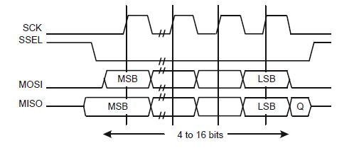
SPI – Serial Peripheral Interface
CPOL == 0, CPHA == 0
Clock polarity idle state is low
Data capture occurs on clock rising edge
Diagram is for LPC23xx which provides for frame sizes between 4 and 16 bits

Slide 10
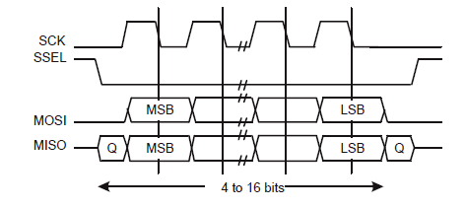
SPI – Serial Peripheral Interface
CPOL == 0, CPHA == 1
Clock polarity idle state is low
Data capture occurs on clock falling edge
Diagram is for LPC23xx which provides for frame sizes between 4 and 16 bits

Slide 11
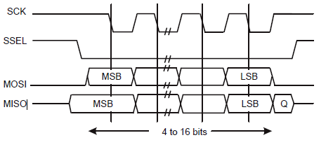
SPI – Serial Peripheral Interface
CPOL == 1, CPHA == 0
Clock polarity idle state is high
Data capture occurs on clock falling edge
Diagram is for LPC23xx which provides for frame sizes between 4 and 16 bits

Slide 12
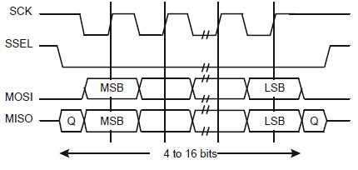
SPI – Serial Peripheral Interface
CPOL == 1, CPHA == 1
Clock polarity idle state is high
Data capture occurs on clock rising edge
Diagram is for LPC23xx which provides for frame sizes between 4 and 16 bits

Slide 13
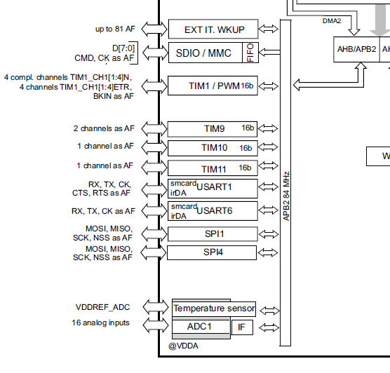
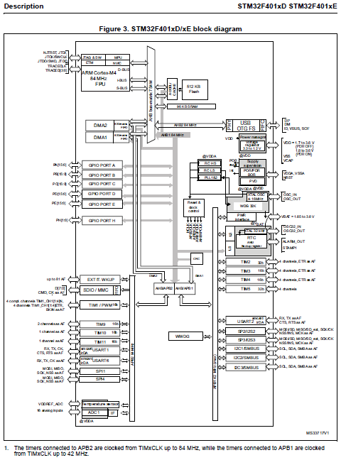
Block diagram showing SPI1
Reference: http://www.st.com/web/en/resource/technical/document/datasheet/DM00102166.pdf

Slide 14
SPI – Serial Peripheral Interface
void BspSPI1Init()
{
RCC_APB2PeriphClockCmd(RCC_APB2Periph_SPI1, ENABLE);
SPI_InitTypeDef SPI_InitTypeDefStruct;
SPI_InitTypeDefStruct.SPI_Direction = SPI_Direction_2Lines_FullDuplex;
SPI_InitTypeDefStruct.SPI_Mode = SPI_Mode_Master;
SPI_InitTypeDefStruct.SPI_DataSize = SPI_DataSize_8b;
SPI_InitTypeDefStruct.SPI_CPOL = SPI_CPOL_Low;
SPI_InitTypeDefStruct.SPI_CPHA = SPI_CPHA_1Edge;
SPI_InitTypeDefStruct.SPI_NSS = SPI_NSS_Soft;
SPI_InitTypeDefStruct.SPI_BaudRatePrescaler = SPI_BaudRatePrescaler_32;
SPI_InitTypeDefStruct.SPI_FirstBit = SPI_FirstBit_MSB;
SPI_Init(SPI1, &SPI_InitTypeDefStruct); continued …

Slide 15
SPI – Serial Peripheral Interface
/*-------- Configure SCK, MISO, MOSI --------*/
GPIO_InitStruct.GPIO_Pin = GPIO_Pin_5 | GPIO_Pin_6 | GPIO_Pin_7;
GPIO_InitStruct.GPIO_Mode = GPIO_Mode_AF;
GPIO_InitStruct.GPIO_Speed = GPIO_Speed_100MHz;
GPIO_InitStruct.GPIO_OType = GPIO_OType_PP;
GPIO_InitStruct.GPIO_PuPd = GPIO_PuPd_NOPULL;
GPIO_Init(GPIOA, &GPIO_InitStruct);
/*--------- Configure alternate GPIO functions to SPI1 ------*/
GPIO_PinAFConfig(GPIOA, GPIO_PinSource5, GPIO_AF_SPI1);
GPIO_PinAFConfig(GPIOA, GPIO_PinSource6, GPIO_AF_SPI1);
GPIO_PinAFConfig(GPIOA, GPIO_PinSource7, GPIO_AF_SPI1);
SPI_Cmd(SPI1, ENABLE);
}

Slide 16
I2C Inter-Integrated Circuit

Slide 17
I2C Inter-Integrated Circuit
I2C-bus is a de facto world standard
Implemented in over 1000 different ICs manufactured by more than 50 companies
V1 1982
100-kHz clock – default used in our MP3 project
7-bit slave addresses – used in our MP3 project
1992 added 400-kHz Fast-mode (try it!) and 10-bit slave addresses
V2 1998 added 3.4-MHz High-speed mode
…
V6 2014 latest with 5-MHz Ultra Fast-mode and other features
Compare to SPI which can go up to 42 MHz on our STM32.
References: Wikipedia, and http://www.nxp.com/documents/user_manual/UM10204.pdf

Slide 18
I2C
Design
Uses only two bidirectional open-drain lines
SDA, Serial Data Line
SCL Serial Clock Line
pulled up with resistors, i.e. idle state is high.
Master device initiates data transfers between Slave device(s) and memory
Each slave has a unique address
Compare to SPI where each slave has a chip-select line instead of an address

Slide 19
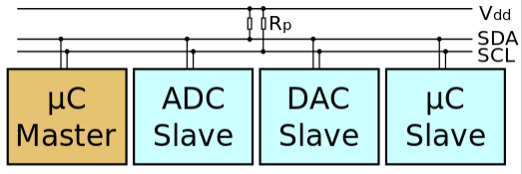
I2C
Example circuit
Master is a microcontroller
3 Slave devices
ADC
DAC
Another microcontroller
SDA and SCL are pulled high by Vdd, i.e. to transmit “0”, device pulls the SDA line down, to transmit “1” device does not pull the SDA line down.

Slide 20
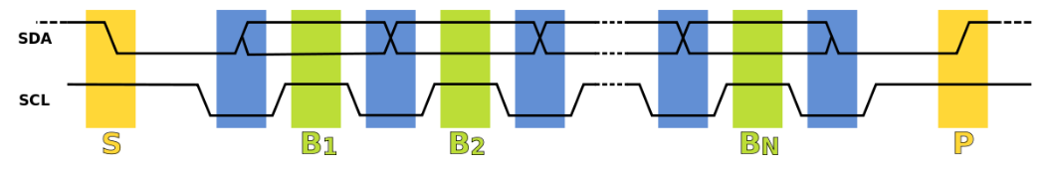
I2C
Overview of I2C data transmission
Start Bit S: Master initiates transmission with a start bit:
while clock (SCL) is idle (high), Master pulls data (SDA) low
Clock pulses are then initiated
Set data: Falling SCL edge triggers first SDA bit to be set while clock is low (blue region)
Sample data: Clock pulses high at which point bit B1 is sampled (received)
Clock continues to pulse and SDA transmits 1 bit per pulse. Bits are set in blue regions when clock drops low and sampled in green regions when clock rises high.
Stop Bit P: Master concludes transmission with a stop bit (yellow region P):
while clock (SCL) is idle (high), Master allows data (SDA) to go high

Slide 21
I2C
Write to Slave
S=Start bit
SLAVE ADDRESS=7-bit address
Command bit = 0 for write
A=ACK=0 returned by Slave to Master
DATA= 8 bits … multiple bytes may be written by master
A/A= ACK/NACK, NACK indicates problem, can resend
P=Stop bit
Master to Slave
Slave to Master

Slide 22
I2C
Read from Slave – direct read
S=Start bit
SLAVE ADDRESS=7-bit address
R/W = Command bit = 1 for read
DATA= 8 bits … multiple bytes may be read
A/A = ACK/NACK from receiver
P=Stop bit
Master to Slave
Slave to Master

Slide 23
I2C
Combined format
Sr is a Repeated Start Bit which serves to keep the connection open with the Slave
DATA may consist of any number of bytes from sender with corresponding ACK/NACK from receiver
Example: to read touch points from our touch panel we first send the address of the register we want to read, then we read the register contents.
Master to Slave
Slave to Master
Direction depends on preceding R or W

Slide 24
Communicating with the FT6206 (touch)
Capacitive Touch Pins (Adafruit)
SDA - This is the I2C data pin used by the FT6206 capacitive touch controller chip. It can be shared with other I2C devices. On Arduino UNO this pin is also known as Analog 4.
SCL - This is the I2C clock pin used by the FT6206 capacitive touch controller chip. It can be shared with other I2C devices. On UNO this pin is also known as Analog 5.

Slide 25
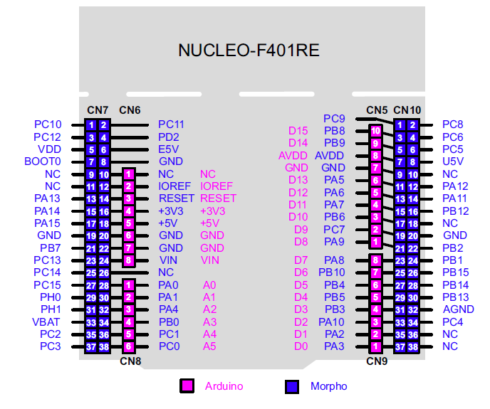
Communicating with the FT6206 (touch)
SDA – A4 PB9
SCL – A5 PB8
Alternate wiring on our boards has A4/A5 connected to PB9/PB8

Slide 26
Intro to C++
Class
We’ll limit our intro to C++ features that are used in our project code
Class: definition: the encapsulation of a data structure together with the functions or “methods” to operate on it
In C++, a class is defined in a header file
A C++ class definition can be understood as an enhanced struct definition
Key enhancements include
private and public tags on data fields and functions (class members) to determine which parts of the class a client application can access
Function overload: a function can be defined multiple times with the same name but different parameter lists
Inheritance: a subclass (or derived class) can inherit from a base class and add more features to make a new hybrid subclass.
Virtual functions: a subclass can override the base class definition of a function tagged as virtual. The function prototype is preserved but the function behavior is modified in the subclass.

Slide 27
Intro to C++
Example header file Rectangle.h:
class Rectangle {
public: // accessible to applications
Rectangle(int x, int y, int w, int h); // constructor
boolean IsInside(int x, int y); // is (x, y) inside the rectangle?
private: // not accessible to applications
int x, y; // top left corner
int w, h; // width, height
};

Slide 28
Intro to C++
Corresponding class implementation in file Rectangle.cpp:
Rectangle::Rectangle(int x, int y, int w, int h) { // Constructor initializes the class fields
this->x = x; // this is an implicit first parameter in every method definition
this->y = y;
this->w = w;
this->h = h;
}
boolean Rectangle::IsInside(int x, int y) {
if (x >= this->x && x <= this->x + w && y >= this->y and y <= this->y + h)
return true; else return false;
}

Slide 29
Intro to C++
(20,0)
(0,0)
(2,2)
(5,5)
(25,5)
Client code that uses class Rectangle:
Rectangle r1 = Rectangle(0, 0, 20, 10); // class instance r1
Rectangle r2 = Rectangle(5, 5, 20, 10); // class instance r2
r1.x = 5; // compiler error, x is private
r1.IsInside(2, 2); // true
r2.IsInside(2, 2); // false
(0,10)
(20,10)
(5,15)
(25,15)

Slide 30
Intro to C++
Base class example. Header file Shape.h:
class Shape {
public:
Shape(char *name) {this->name = name}; // constructor
virtual float Area() = 0; // pure virtual function to compute area of shape
char *GetName() {return name;}; // accessor for applications to retrieve protected
// member
protected: // protected means accessible to subclasses, not applications
char *name; // name of shape
};

Slide 31
Intro to C++
Subclass example header file Rectangle.h:
class Rectangle : public Shape { // inherits from Shape
public:
Rectangle(int x, int y, int w, int h); // constructor
float Area() override; // base class virtual function override
boolean IsInside(int x, int y); // is (x, y) inside the rectangle?
private:
int x, y; // top left corner
int w, h; // width, height
};

Slide 32
Intro to C++
Corresponding class implementation in file Rectangle.cpp:
static const char *name = “rectangle”;
Rectangle::Rectangle(int x, int y, int w, int h) {
this->x = x;
this->y = y;
this->w = w;
this->h = h;
this->name = name; // base class member
}
boolean Rectangle::IsInside(int x, int y) {
if (x >= this->x && x <= this->x + w
&& y >= this->y and y <= this->y + h)
return true; else return false;
}
float Rectangle::Area() {
return (float) w * h;
}

Slide 33
Intro to C++
Subclass example header file Circle.h:
class Circle: public Shape { // inherits from Shape
public:
Circle(int x, int y, int r); // constructor
float Area() override; // base class virtual function override
private:
int x, y, r; // center and radius
};

Slide 34
Intro to C++
Corresponding class implementation in file Circle.cpp:
static const char *name = “circle”;
Circle::Circle(int x, int y, int r) { // constructor
this->x = x;
this->y = y;
this->r= r;
this->name = name; // base class member
}
float Circle::Area() {
return (float) 3.1416 * r * r;
}

Slide 35
Intro to C++
(20,0)
(0,0)
Client code using subclasses:
Rectangle r1 = Rectangle(0, 0, 20, 10); // Rectangle class instance r1
Circle c1 = Circle(5, 5, 5); // Circle class instance c1
char *nameR = r1.name; // compiler error: name is protected
char *nameR = r1.GetName(); // “rectangle”
char *nameC = c1.GetName(); // “circle”
float aR = r1.Area(); // 200
float aC = c1.Area(); // 78.54
(0,10)
(20,10)

Slide 36
Intro to C++
(20,0)
(0,0)
Client code using polymorphism:
Rectangle r1 = Rectangle(0, 0, 20, 10); // Rectangle class instance r1
Circle c1 = Circle(5, 5, 5); // Circle class instance c1
Shape* pShape1 = dynamic_cast<Shape*>(&r1);
Shape* pShape2 = dynamic_cast<Shape*>(&c1);
char *nameR = pShape1->GetName(); // “rectangle”
char *nameC = pShape2->GetName(); // “circle”
float aR = pShape1->Area(); // 200
float aC = pShape2->Area(); // 78.54
(0,10)
(20,10)

Slide 37
Introduction to device Drivers

Slide 38
Device Drivers
What is a Device Driver?
Also referred to simply as a Driver
Software that controls or operates a hardware device
Simplifies control and operation of the device by exposing only a high level interface to client software that uses the device
Aims to standardize the operation procedures for wide ranges of devices by providing a uniform interface across a class of devices e.g. printers, keyboards, etc.
Enables a device to be attached to an OS for use by applications via the driver interface
Examples
Disk Drive driver
Keyboard driver
Video Display driver
USB driver
Touch Panel driver
Printer

Slide 39
Device Drivers

Slide 40
Class Driver
What is a Class Driver?
Supports a wide range of devices with similar characteristics
Uses a common protocol
Hardware makers just need to implement the class interface for their device and any class compliant OS and application can operate the device.
USB has the most prolific examples of class drivers
The USB-IF (Universal Serial Bus Implementers Forum) defines a couple of dozen class specifications such as
Mass Storage Class (memory sticks)
HID Device Class (Keyboards, mice, game controllers, etc.)
Printer Class
Smart Card Class
Video Class (streaming video)
Battery Charging Class

Slide 41
Device Driver Model
What is a Device Driver Model or Framework?
Provides standardized interfaces and protocols for applications to control and operate a device or range of devices
Provides standardized interfaces and protocols for driver developers to enable the device to interact with the OS

Slide 42
Device Driver Model
Two common device driver models:
Block Device Driver Model
Applies to devices that transfer data in fixed size blocks of bytes
Blocks may be accessed in random order
Examples: hard disk, SD card
Character (Char) Device Driver Model
Applies to devices that transfer data in variable length streams of bytes
Access is sequential
Examples: mouse, keyboard

Slide 43
Char Device Driver Model

Slide 44
Char Device Driver Model
Let’s look more closely at the Char Driver model
The Char Driver Model consists of
A standard interface allowing applications to use the device
A standard protocol to follow when using the interface
The Char Device Driver Model follows the Unix file I/O API
Unix chose to unify the interface across devices by treating them like sequential access files
A compliant driver implements the following functions
open(): get a Handle to a specified device
close(): close a Handle to a specified device
read(): read bytes from a specified device
write(): write bytes to a specified device
ioctl(): send a control request to a device – device dependent

Slide 45
Char Device Driver Model
Protocol for using a device under the model
To begin using the device, call open() to obtain an access token to the device (descriptor or handle)
You may then use the handle to call read() to read bytes from the device, or write() to write bytes to the device
To control any special device-dependent features, call ioctl()
When done with the device, call close() to release the device

Slide 46
Char Device Driver Model
Device Handle
HANDLE h = open(“/dev/devx”, flags)
The open function obtains a handle (descriptor in Linux) to a device specified the same way as a file path
The handle is a reference (pointer or index) to a device connection struct which is allocated to the calling application
In our implementation it actually indexes into the table of device drivers directly
Once a handle has been assigned to an application, the application may control and operate the Char device bound to the handle

Slide 47
Char Device Driver Model
ioctl
In the Char Driver Model, ioctl is used to control all the device-specific features of a particular device
open, close, read, write can be expected to work the same way across all devices that follow the Char Driver Model
ioctl is the catch-all function for controlling everything else about a Char device

Slide 48
Example of a Char Driver Model: PJ Driver Framework used in M3Player starter app

Slide 49
PJ Driver Framework – Interface Spec
Open
Close
Read
Write
Ioctl

Slide 50
PJ Driver Framework – Interface Spec
Open
HANDLE Open(char *pName, INT8U flags)
Open a handle to a specified device
pName – name of device within devices directory, eg. /dev/SAM0 (as a C string “/dev/SAM0”)
flags – or’ed flags modeled on Linux file I/O – not currently used in our implementation – pass the value 0. Linux examples:
O_APPEND – append subsequent writes to a file
O_CREAT – create a file
O_TRUNC – truncate the file i.e. prepare to rewrite the file
Returns – a small positive integer or a PJDF error code if something went wrong

Slide 51
PJ Driver Framework – Interface Spec
Close
INT8U Close(HANDLE h)
Close a handle to a device – release the device
h – handle of a device previously returned by Open()
Returns – PJDF_ERR_NONE if successful otherwise an error code

Slide 52
PJ Driver Framework – Interface Spec
Read
INT8U Read(HANDLE h, PVOID pBuffer, INT32U* pLength)
Read data from a device
h – handle of a device previously returned by Open()
pBuffer – pointer to memory buffer of bytes to receive data
pLength – pointer to length of buffer on input, length of transfer on output
Returns – PJDF_ERR_NONE if successful

Slide 53
PJ Driver Framework – Interface Spec
Write
INT8U Write(HANDLE h, void* pBuffer,INT32U* pLength)
Write data to a device
h – handle of a device previously returned by Open()
pBuffer – pointer to memory buffer of bytes to write
pLength – pointer to length of buffer on input, length of transfer on output
Returns – PJDF_ERR_NONE if successful

Slide 54
PJ Driver Framework – Interface Spec
Ioctl
INT8U Ioctl(HANDLE h, INT8U request, void* pArgs,
INT32U* pSize)
Perform device I/O control on a device
h – handle of a device previously returned by Open()
request – code number of a request – available codes depend on the device
pArgs– pointer to memory buffer of bytes to send/receive data
pLength – pointer to length of buffer on input, length of transfer on output
Returns – PJDF_ERR_NONE if successful

Slide 55
PJ Driver Framework – Internals simplified
Driver management
Internal representation of drivers
Mechanism for accessing a specific driver function via the application interface

Slide 56
PJ Driver Framework – Internals simplified
Application code
pjdf.c
driversInternal[]
Calls generic driver functions in pjdf.c to perform Open, Close, Read, Write, Ioctl for a selected device.
Generic code to
open, close, read, write, ioctl
for any of N devices.
0 | *pName= *Open= *Close= *Read= *Write= *Ioctl= | “/dev/devA” OpenA() CloseA() ReadA() WriteA() IoctlA()
1 | *pName= *Open= *Close= *Read= *Write= *Ioctl= | “/dev/devB” OpenB() CloseB() ReadB() WriteB() IoctlB()
2 | … | …
N-1 | … | …
pjdf.c manages the drivers internally with an array of structs where each (simplified) struct contains:
Pointer to name (string) of device i
Pointer to Open() for device i
Pointer to Close() for device i
Pointer to Read() for device i
Pointer to Write() for device i
Pointer to Ioctl() for device i

Slide 57
PJ Driver Framework – Internals simplified
Application code
pjdf.c
driversInternal[]
hB = Open(“/dev/devB”, 0); // hB is returned as 2
Generic code for Open():
Search for driver “/dev/devB”
Call Open() of the found driver
Return driversInternal index+1 i.e. 2
0 | *pName= *Open= *Close= *Read= *Write= *Ioctl= | “dev/devA” OpenA() CloseA() ReadA() WriteA() IoctlA()
1 | *pName= *Open= *Close= *Read= *Write= *Ioctl= | “/dev/devB” OpenB() CloseB() ReadB() WriteB() IoctlB()
Code for OpenB():
Do stuff to open device B

Slide 58
PJ Driver Framework – Internals simplified
Application code
pjdf.c
driversInternal[]
char *buf = “data”; INT32U len = 4; Write(hB, buf, &len); // hB is 2
Generic code for Write():
Driver index = hB – 1 = 1
Call Write() for driver 1
0 | *pName= *Open= *Close= *Read= *Write= *Ioctl= | “/dev/devA” OpenA() CloseA() ReadA() WriteA() IoctlA()
1 | *pName= *Open= *Close= *Read= *Write= *Ioctl= | “/dev/devB” OpenB() CloseB() ReadB() WriteB() IoctlB()
Code for WriteB():
Do stuff to write buf to device B

Slide 59
PJ Driver Framework – Internals simplified
Application code
pjdf.c
driversInternal[]
char buf[4]; INT32U len = 4; Read(hB, buf, &len); // hB is 2
Generic code for Read():
Driver index = hB – 1 = 1
Call Read() for driver 1
0 | *pName= *Open= *Close= *Read= *Write= *Ioctl= | “/dev/devA” OpenA() CloseA() ReadA() WriteA() IoctlA()
1 | *pName= *Open= *Close= *Read= *Write= *Ioctl= | “/dev/devB” OpenB() CloseB() ReadB() WriteB() IoctlB()
Code for ReadB():
Do stuff to read from device B into buf

Slide 60
MP3Player PJDF Device Drivers
Multiple drivers are implemented in the MP3Player starter app

Slide 61
MP3Player PJDF Device Drivers
The MP3Player starter app contains three or more PJDF device drivers. Names of the drivers are defined in pjdf.h:
#define PJDF_DEVICE_ID_SPI1 "/dev/spi1"
#define PJDF_DEVICE_ID_MP3_VS1053 "/dev/mp3_vs1053"
#define PJDF_DEVICE_ID_LCD_ILI9341 "/dev/lcd_ili9341“
The SPI driver is used to send/receive data between the memory and a peripheral device through a Serial Peripheral Interface (SPI)
The MP3 driver is used to control the peripheral VS1053 MP3 decoder chip. The MP3 driver can be viewed as a simple wrapper around a SPI driver which is used to send commands and data to the MP3 decoder.
The LCD driver is used to control the peripheral ILI9341 display. Like the MP3 driver it is also a wrapper around a SPI driver used to send commands and data to the display.
It so happens that both the VS1053 and the ILI9341 are connected to the same SPI GPIO pins on the NUCLEO (SPI1). Since they share the SPI resource their accesses to it have to be serialized (using a semaphore).

Slide 62
MP3Player PJDF Device Drivers
Example: application writes to LCD:
Application calls Write(hLCD, buf, &len)
LCD Driver waits for SPI1 semaphore
LCD Driver asserts LCD Chip Select (GPIO)
LCD Driver calls Write(hSPI, buf, &len)
SPI1 Driver calls BSP functions to perform Write operation(s) on SPI1 Hardware
LCD Driver de-asserts LCD Chip Select
LCD Driver releases SPI1 semaphore
LCD
Driver
Read/
Write/
Ioctl
MP3
Driver
SPI1
Driver
MP3 Chip Select
LCD Chip Select
BSP Calls
SRAM/FLASH
SPI1
Hardware
VS1053 MP3 decoder
ILI9341 LCD
Data bus
Data bus

Slide 63
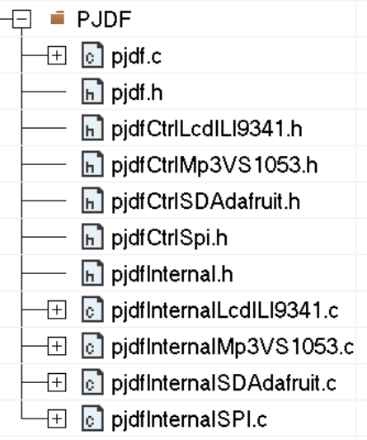
MP3Player PJDF Device Drivers
PJFD source code organization
Interface (.h) exposed to applications,
and its implementation (.c)
Ioctl interface (.h) per device
Internal interface (.h), and implementation
per device (.c)

Slide 64
MP3Player Device Drivers
PJFD source code organization
Application code
pjdf.h
The public driver interface exposed to applications
pjdf.c
Implements pjdf.h
pjdfInternalLcdILI9341.c
Developer implementation of
pjdfInternal.h for the LCD hardware
pjdfCtrlLcdILI9341.h
Public Ioctl definitions for the LCD
pjdfInternal.h
Internal driver interface to
be implemented by driver
developers.
pjdfInternalMp3VS1053.c
Developer implementation of
pjdfInternal.h for the MP3 hardware
pjdfCtrlMp3VS1053.h
Public Ioctl definitions for the MP3 decoder
pjdfCtrlSpi.h
Public Ioctl definitions for the SPI hardware
pjdfInternalSPI.c
Developer implementation of
pjdfInternal.h for the SPI hardware

Slide 65
MP3Player Device Drivers
Adding a new driver

Slide 66
MP3Player Device Drivers
Adding a new driver
pjdfInternal.h
pjdfInternal.h is the interface to be implemented by device driver developers
It consists of the 5 standard functions to implement per device:
Open(), Close(), Read(), Write(), Ioctl()
And one additional function per device:
Init(): function for initializing the device before it is exposed to applications i.e. before multitasking begins
To make this work, function InitPjdf() is provided by the framework and is called before multitasking begins. It calls the Init() function for each PJDF driver.

Slide 67
MP3Player Device Drivers
Adding the touch driver to the PJDF framework
This driver should be simpler to add than the MP3 or LCD drivers
The touch controller does not use SPI, instead it uses I2C
Currently, the MP3Player starter app directly calls BSP functions when it wants to read or write to the I2C bus.
Your job will be to replace those direct BSP calls with calls to Open(), Close(), Read(), Write() and Ioctl() as necessary. Of course you will need to implement those functions as well.

Slide 68
MP3Player Device Drivers
Steps to add the I2C driver to the PJDF framework
Start in pjdf.h
Observe the “TODO LIST” for developers
Add the new driver ID:
#define PJDF_DEVICE_ID_I2C1 "/dev/sd_I2C1"
etc – see the TODO LIST

Slide 69
Assignment 5
Touch Driver

